Slide 1
Traffic Flow Regulation Using Image Processing
Signal and Image Processing – 21AIE303
Batch – B Group -17

Slide 2


01
02
Team Members
03
04
Parthvi Manoj
CB.EN.U4AIE21143
Sakthi Swaroopan S
CB.EN.U4AIE21159
Sanjay Chidambaram
CB.EN.U4AIE21160
Taruneshwaran T
CB.EN.U4AIE21170

Slide 3

Problem Statement
Traffic Signal Optimization using Image and Video Analysis
Traffic congestion is a pervasive issue in urban areas, leading to increased travel time, fuel consumption, and environmental pollution. Traditional traffic signal systems lack adaptability and struggle to efficiently handle varying traffic conditions.
The problem is to design a system that optimizes traffic signal timings based on real-time traffic data, enhancing traffic flow and reducing congestion. In this context, leveraging advanced image analysis techniques becomes crucial for developing a smart and responsive traffic signal control mechanism.

Slide 4
Image Analysis
"Image Processing Symphony: From Reference to Recognition, Unveiling Traffic Signals"

Slide 5
TRAFFIC SIGNAL OPTIMIZATION USING IMAGE ANALYSIS
WORKFLOW OF THE CODE
Image Preprocessing
Edge Detection and Analysis (Reference Image)
Preprocess Captured Image
Edge Detection and Analysis (Captured Image)
Output Display
Traffic Signal Control based on Matching Score
Image Matching using Normalized Cross-Correlation (NCC)

Slide 6
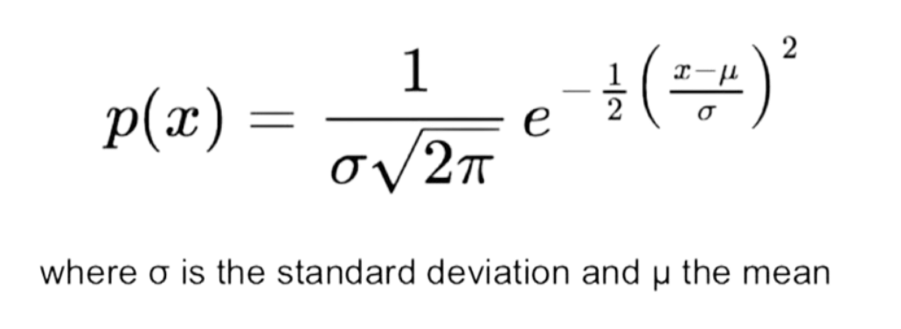
IMAGE ANALYSIS WORKFLOW OF THE CODE
1. Image Preprocessing:
Load Reference Image: Load an image that serves as the reference for traffic signal control.
Select Region of Interest: Allow user-defined selection of a specific area for analysis.
Enhance Reference Image: Apply power-law transformation to enhance the selected region.
Enhanced Image = c × (Original Image)^{ɣ}
2. Edge Detection and Analysis (Reference Image):
Generate Gaussian Derivative Filters: Create X and Y directional filters using 2D Gaussian derivatives.
Convolve Filters for Edge Detection: Compute X and Y directional derivatives by convolving filters with the enhanced reference image.
Calculate Gradient Magnitude: Determine gradient magnitude from the computed directional derivatives.
Thresholding and Edge Thinning: Set thresholds based on gradient magnitude and perform edge thinning for refining edges.

Slide 7
IMAGE ANALYSIS WORKFLOW OF THE CODE
3. Preprocess Captured Image:
Load Captured Image: Load an image captured in real-time for comparison.
Select Region of Interest: Allow user-defined selection of a specific area for analysis in the captured image.
Enhance Captured Image: Apply power-law transformation to enhance the selected region in the captured image.
4. Edge Detection and Analysis (Captured Image):
Use Existing Gaussian Filters: Apply the same set of Gaussian derivative filters to the enhanced captured image.
Compute X and Y Directional Derivatives: Convolve filters with the captured image to compute X and Y directional derivatives.
Calculate Gradient Magnitude and Perform Thresholding: Determine gradient magnitude and apply thresholding for edge detection in the captured image.

Slide 8
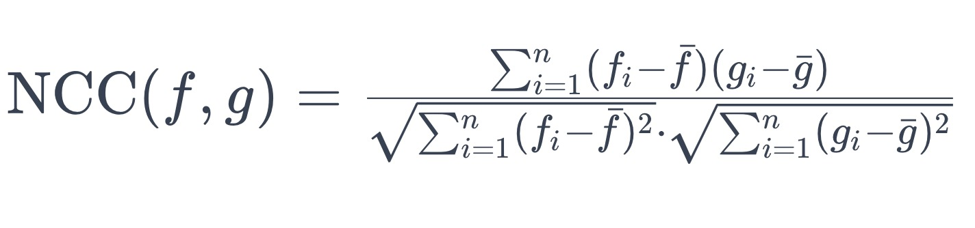
IMAGE ANALYSIS WORKFLOW OF THE CODE
5. Image Matching using Normalized Cross-Correlation (NCC):
Compute Normalized Cross-Correlation (NCC): Use NCC to assess similarity between the processed reference and captured images.
Calculate Matching Score: Determine a matching score indicating the level of similarity between the two images.
6. Traffic Signal Control based on Matching Score:
Evaluate Matching Score: Assess the computed matching score to decide the signal timing adjustments.
Adjust Signal Durations: Determine green and red signal durations based on predefined matching score thresholds.
7. Output Display:
Display Matching Score: Show the calculated matching score.
Show Signal Timings: Display the determined durations for green and red signals based on the matching score.

Slide 9
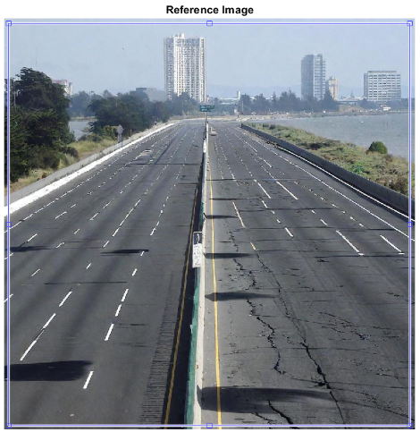
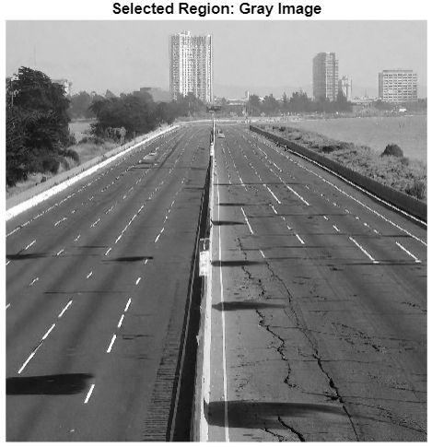
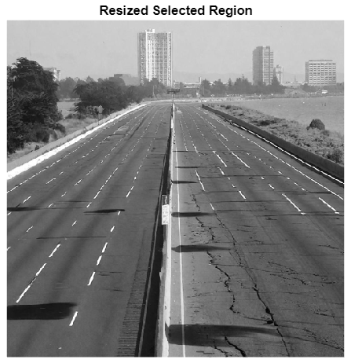
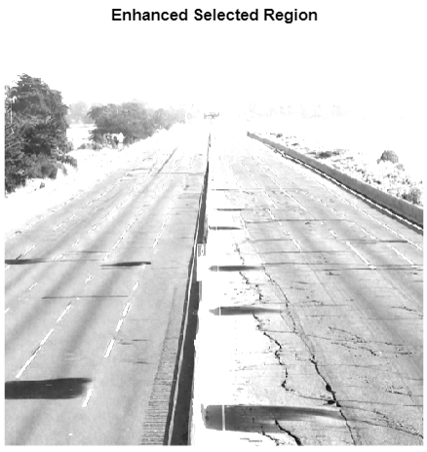
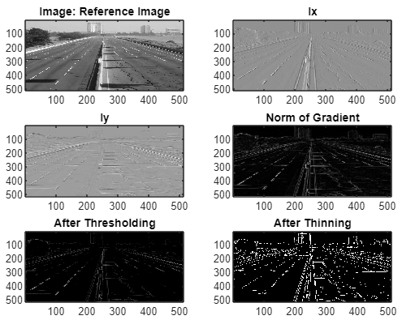
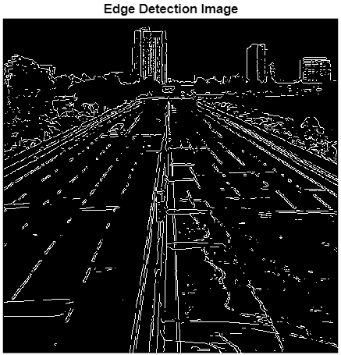
Image Analysis – Output - Reference Image

Slide 10
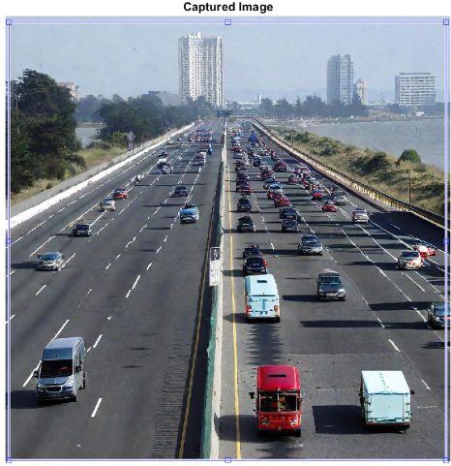
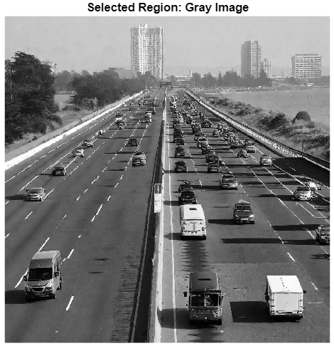

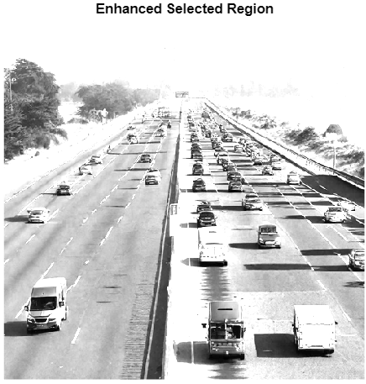
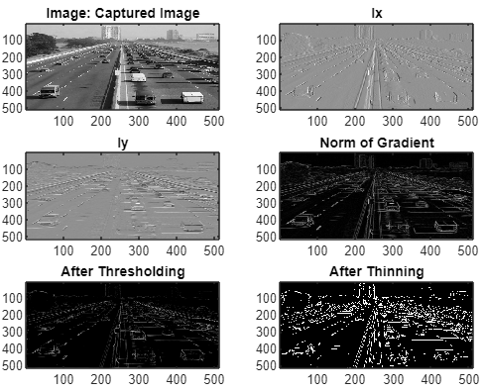
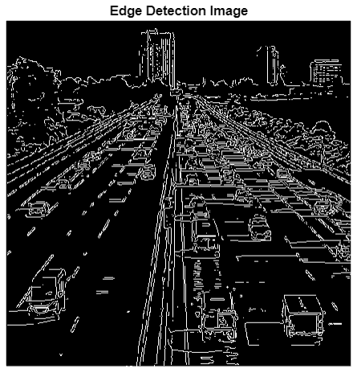
Image Analysis – Output – Input Image

Slide 11


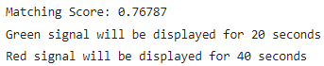
Image Analysis – Output
Reference Image
vs
Input Image

Slide 12
Video Analysis
An Example of Traffic Analysis on a specific Lane in a Busy Road

Slide 13
Workflow for Video Analysis
Video Input
Masking
Binary Conversion
Prewitt Edge Detection
Frame by Frame
Converting to Grayscale
Morphological Operations (Opening)
Blob Analysis

Slide 14
Video Input & Frame Extraction
Video Feed Scenario
Frame Extraction
Traffic Signal
The Video feed will from existing traffic cameras in the city
At a fixed interval a frame is retrieved to be processed
Based on the result from processing the Signal is update

Slide 15
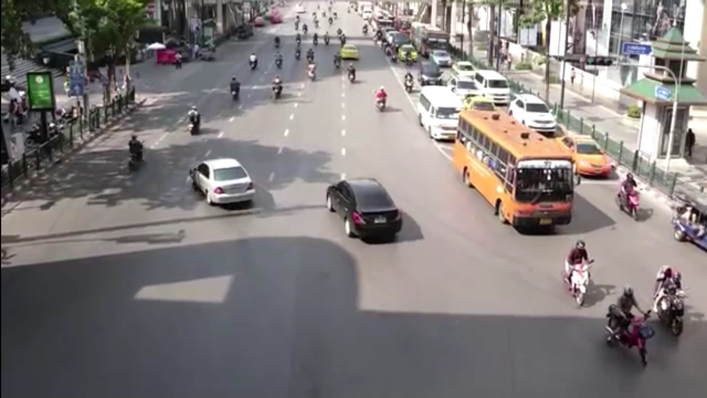

Masking
Example Frame
Mask to be Applied

Slide 16
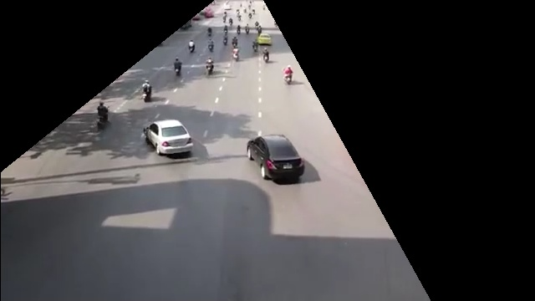
Masking
We need to Mask the Frame to specifiy our region of interest in the frame taken for analysis
This wont change as the Traffic Camera would be in a fixed location
Masked Image

Slide 17
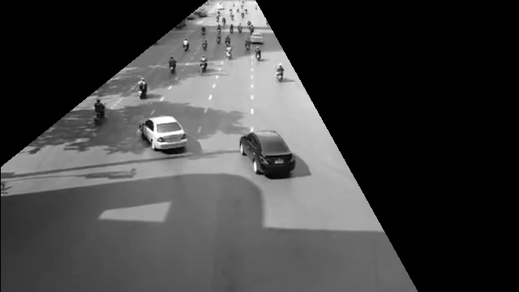
Converting to Grayscale
Need to convert to grayscale to then convert to a Binary (Pure Black & White Image) to use in edge detection
Grayscale Image

Slide 18
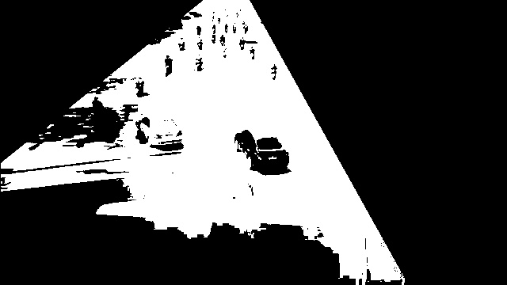
Binary Conversion
Pure Black and White Image

Slide 19

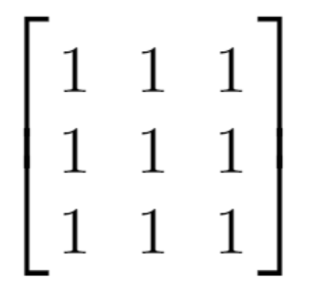
Morphological Operation (Opening)
Structuring Element
Performing Erosion then Dilution to eliminate any floating blobs

Slide 20
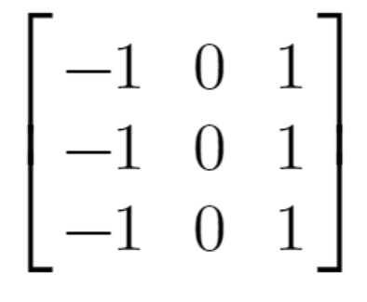
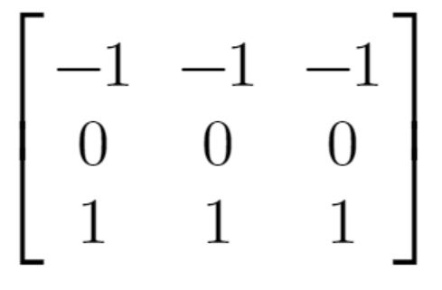
Prewitt Edge Detection
Structuring Element for
X Axis
Structuring Element for
Y Axis
Need to do X axis and Y axis seperately

Slide 21
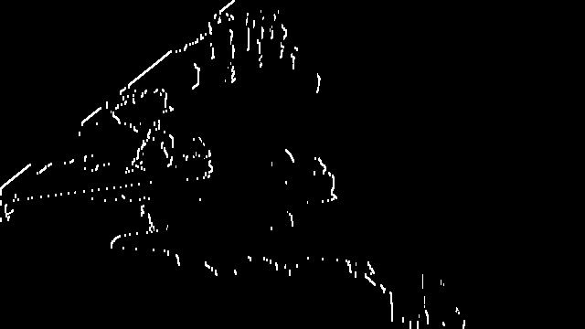
Prewitt Edge Detection
Edges Detected along X-axis

Slide 22
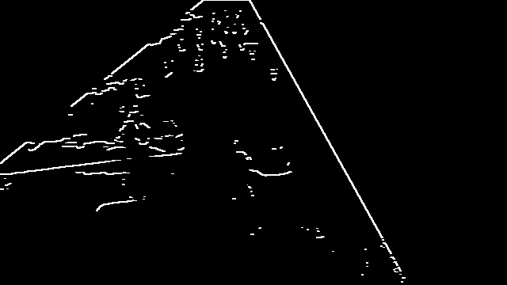
Prewitt Edge Detection
Edges Detected along Y-axis

Slide 23
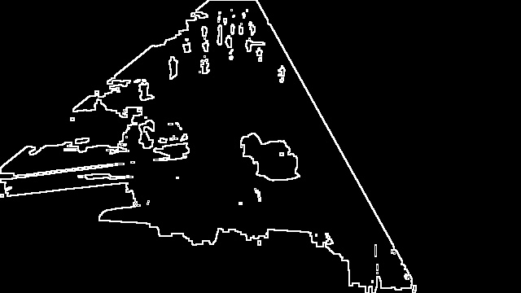
Prewitt Edge Detection
Combining both X axis and Y axis Edges into single image
We are squaring to remove any negative values that may be there in the image
prewitt = np.sqrt(prewitt_x**2 + prewitt_y**2)

Slide 24
Blob Analysis
Bob Analysis is a way of detecting big groups of connected pixels, usually used in conjunction with binary-like images, with clear contrast between regions in the picture
As there are multiple ways to analyse the image that we have processed so far like Canny Edge Detection (Edge tracking by Hysteresis), Template Matching, Density-Based Clustering (A ML Clustering Algorithm), etc…
In our case we are using Blob analysis as a set example for how this processed image can be used for analysis.
Note:
We have added a “tolerance” value to account for any unexpected imperfections that may occur when capturing our frame and to account for the number of vehicles we consider to be too much to stay held back in the Red Signal

Slide 25
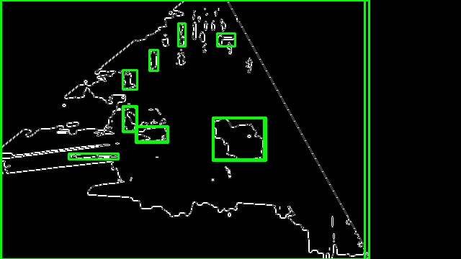
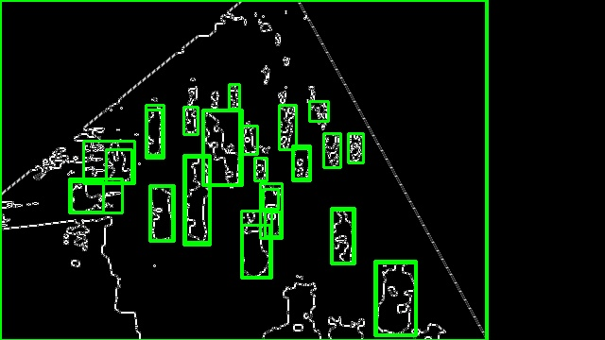
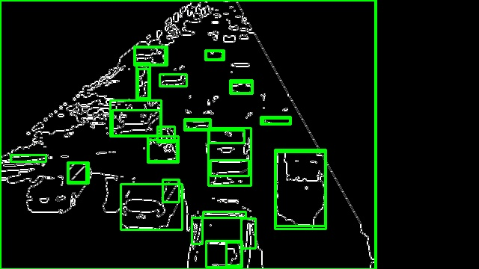
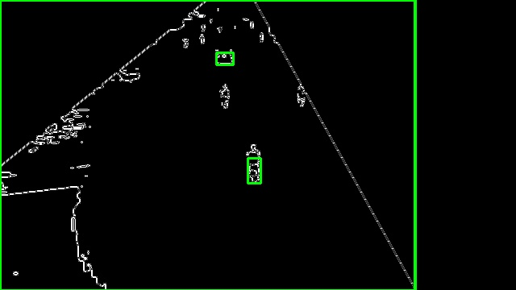
Blob Analysis Results
Note:
We have added a “tolerance” value to account for any unexpected imperfections that may occur when capturing our frame and to account for the number of vehicles we consider to be too much to stay held back in the Red Signal

Slide 26
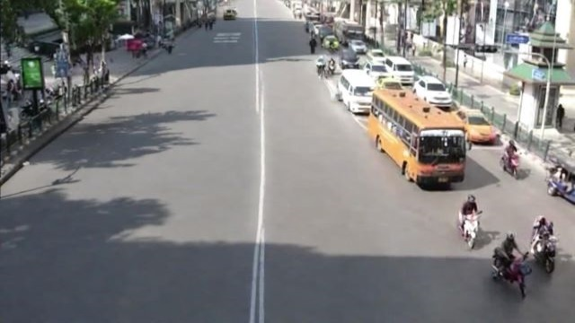
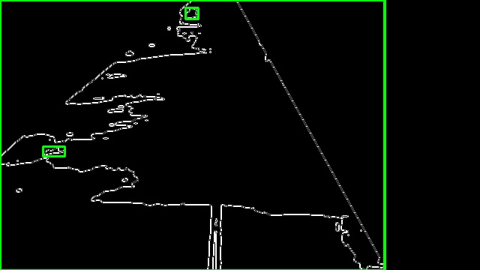
Output
Reference for Empty Road
Processed Image of Empty Road
Using this Image as the reference for a Empty Road
As Mentioned earlier we would need to add a threshold value separately to account for the number of vehicles we are allowed to hold back at the signal before the number becomes too much

Slide 27
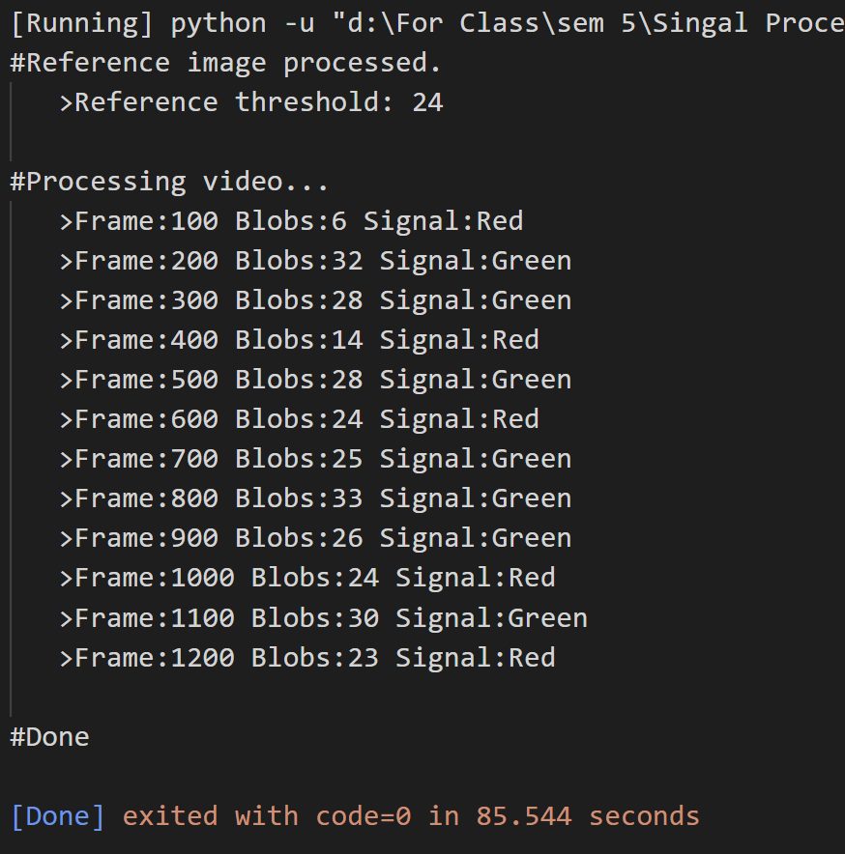
Output

Slide 28
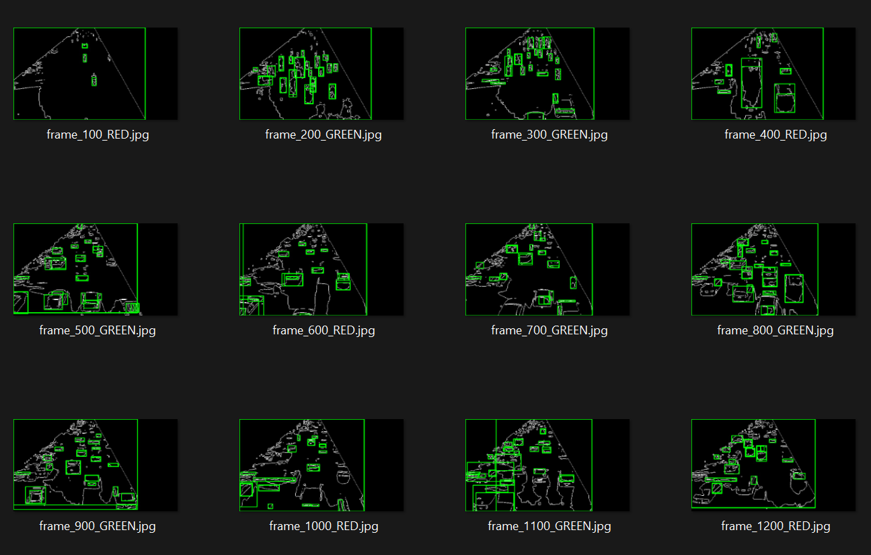
Output

Slide 29
References
Optical Flow Based Moving Object Detection and Tracking for Traffic Surveillance
https://research.iaun.ac.ir/pd/mahdavinasab/pdfs/PaperM_8653.pdf
Smart traffic light control system using image processing
https://iopscience.iop.org/article/10.1088/1757-899X/1088/1/012021/pdf
The paper presents an automated traffic surveillance system using stationary cameras. It employs optical flow estimation, computer vision, and image processing for motion detection and tracking. The system effectively removes noise and unwanted objects through techniques like median filtering and blob analysis. Experimental results demonstrate successful detection and tracking of moving objects in urban videos, showcasing the system's value for traffic surveillance.
The paper describes the development of an adaptive traffic light control system using image processing. It analyzes traffic density and allocates time based on image matching, reducing the need for additional hardware.
The study compares edge detectors and concludes that Canny edge detection is the most effective. The system aims to reduce traffic congestion and improve traffic management

Slide 30
THANK YOU!

